Slide 1
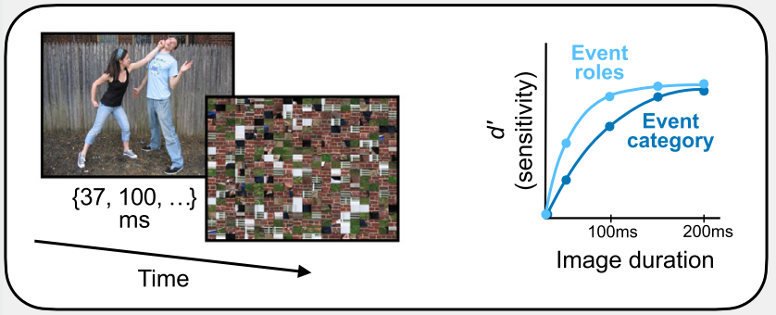
Brief Actions-in-Context
Scene
Action
Behavioural experiment
What comes first? Action or context?

Slide 2
Inspiration : Event role vs category
Hafri et al. (2012); Hafri & Firestone (2021)

Slide 3
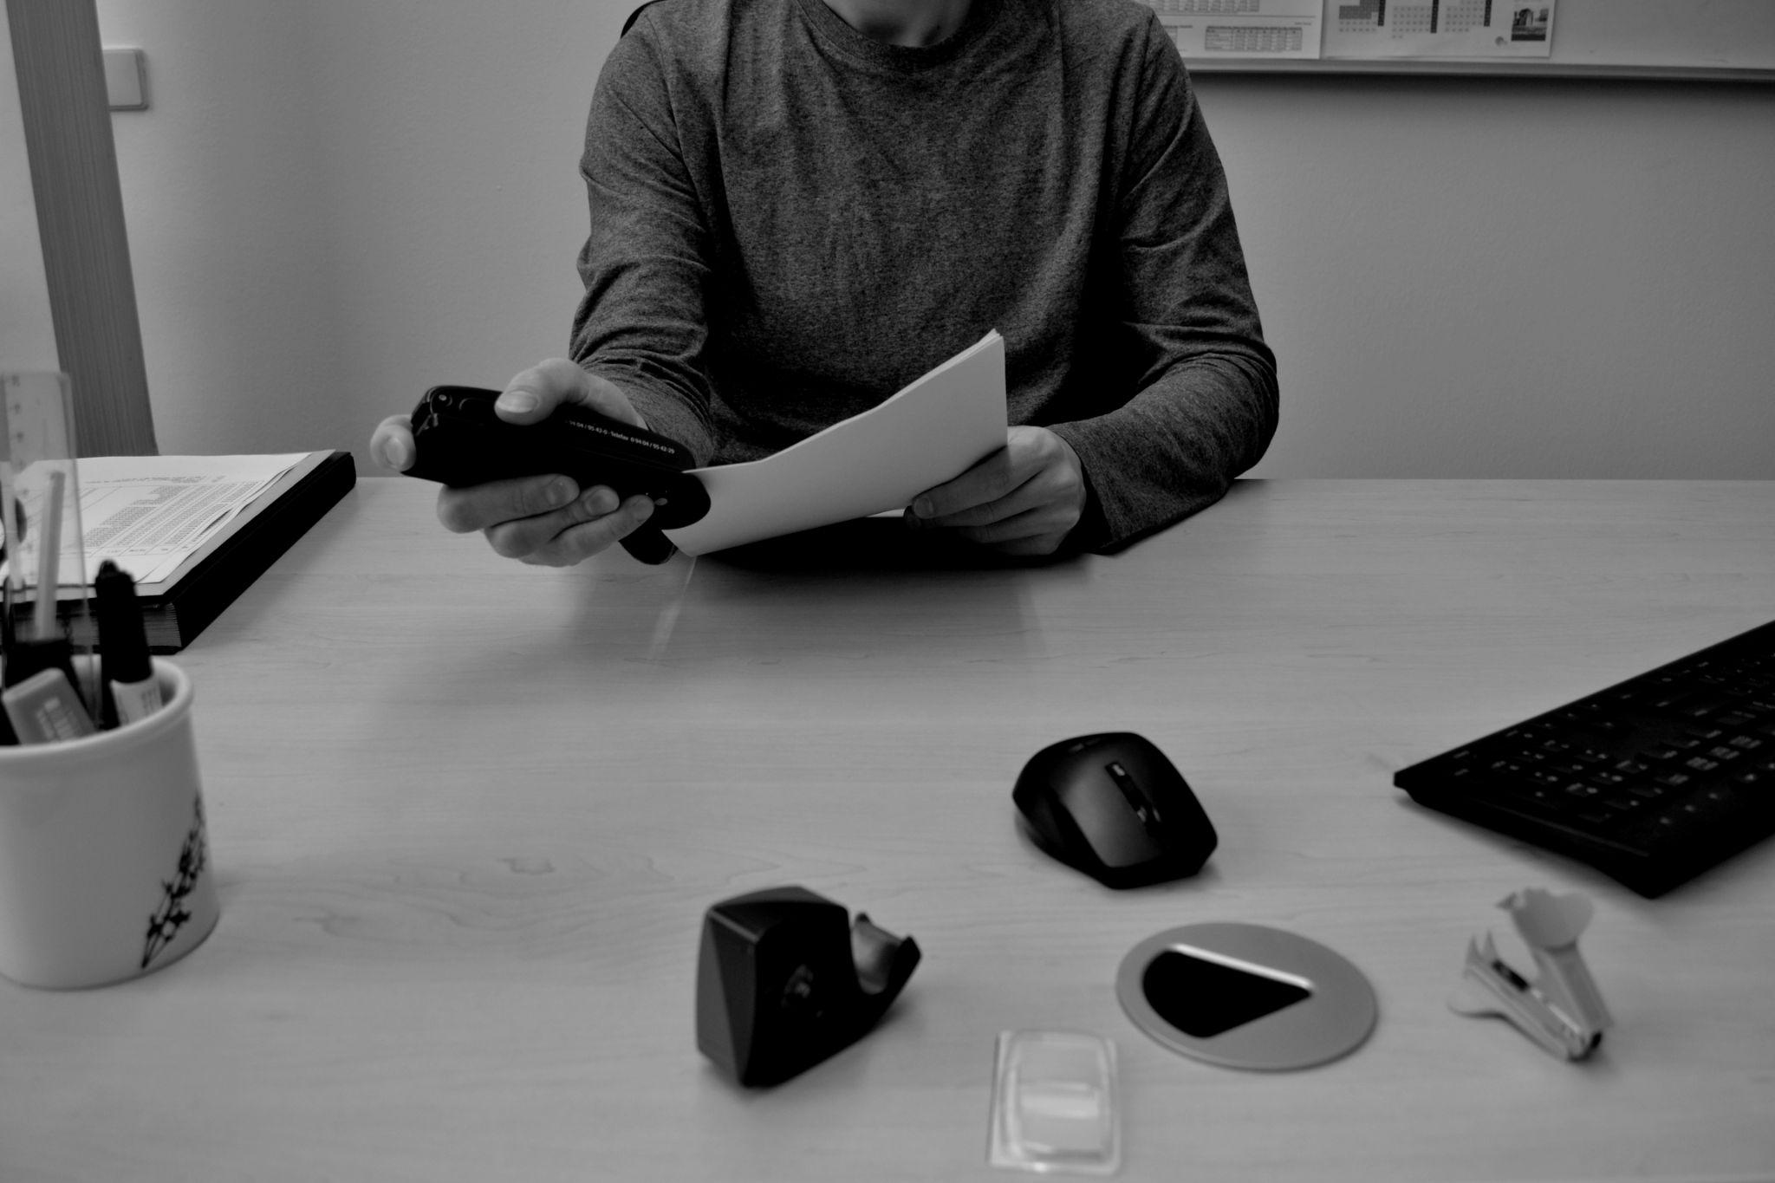
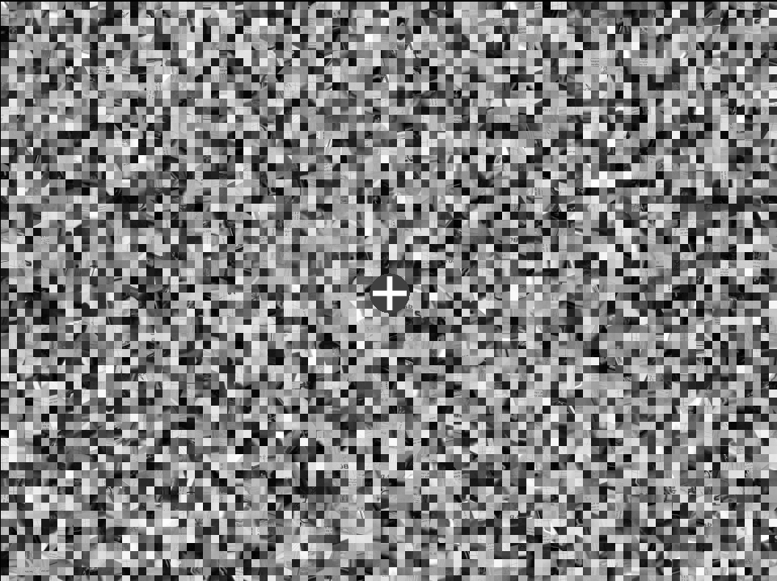
Fast Context-Action recognition
?
Scene
Action

Slide 4
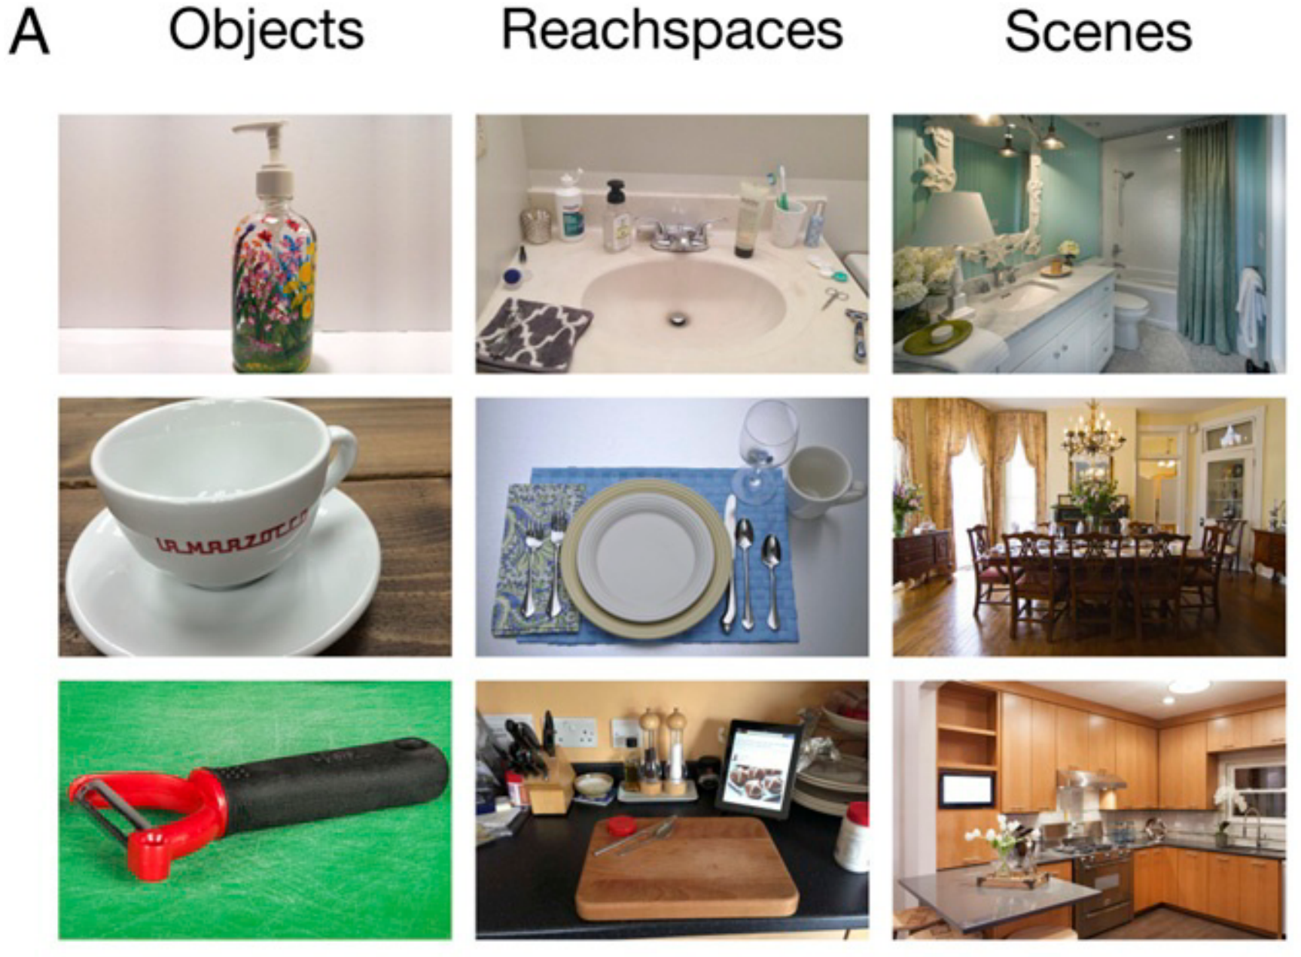
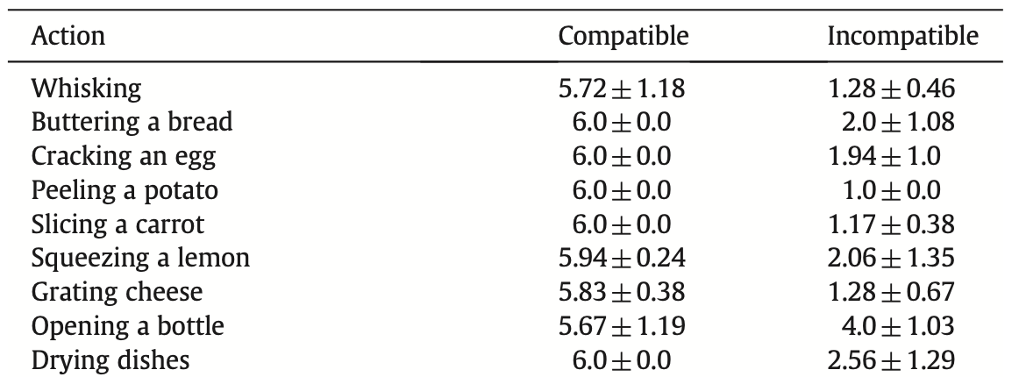
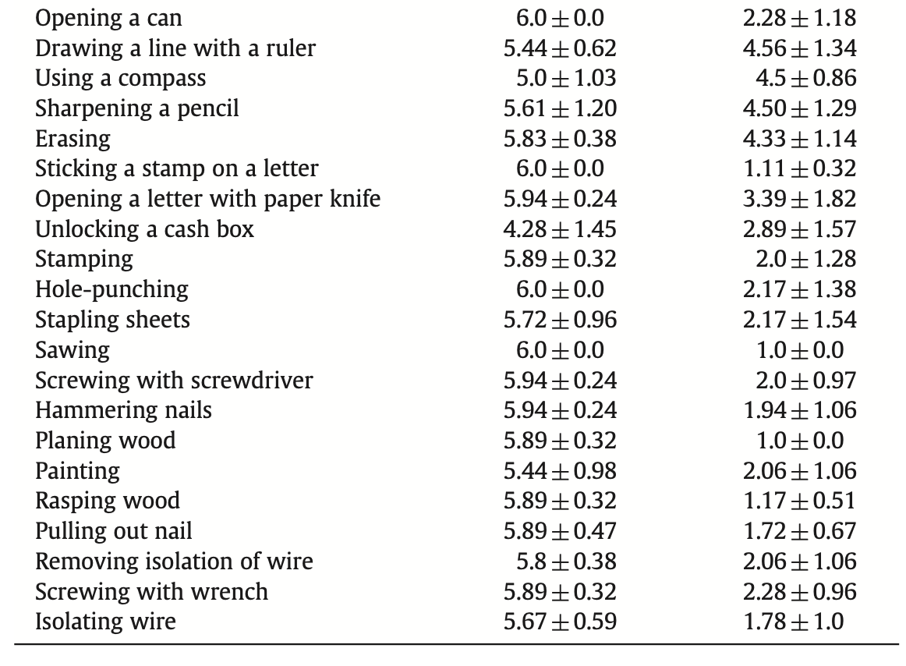


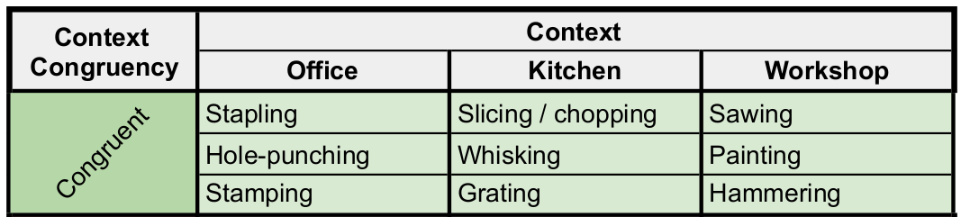
Stimuli
Kitchen
(B&W) Photos of actions and contexts
3rd-person view
Scale ~ reachspaces [~Konkle]
Actions & context pool
High compatibility & low incompatibility [~Wurm]
Kitchen, Office, Workshop
Variability
Viewpoints x 2 : frontal & lateral
Actors x 2
Context exemplars x 2
Example: Office context & action
Office
Workshop
Likert scale: 1 - very unlikely; 6 - very likely
Notes:
We decided to record our own stimuli since we want to control the variables that describe the interaction.
Reachspaces
Additionally, we want to have the scenes captured from the scale of reachspaces,
Which represents an intermediate scale of scenes introduced by Emelie Josephs and Talia Konkle.
These have been found to be represented in the brain differently than zoomed-in objects and zoomed-out navigable scenes.
Actions & contexts
We selected action categories and their contexts from a study by Moritz Wurm and Ricarda Schubotz.
We selected three contexts: kitchen, office and workshop with two actions each.

Slide 5
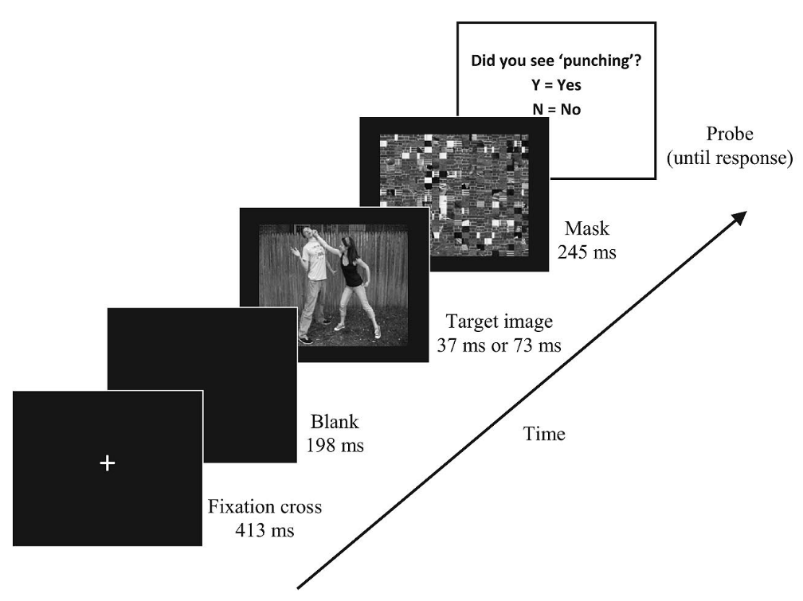
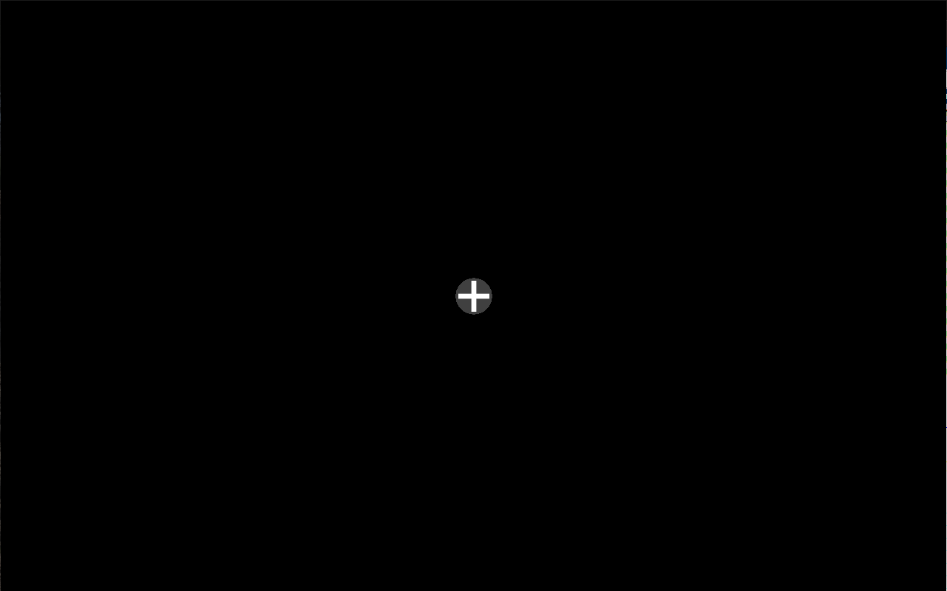
Design
Hafri et al. (2012)
*In ms: 33,50,66,83,116ms
Stapling?
← : no
→ : yes
Probe
(until response, max 2.5 s)
Mask
250 ms
Target
2 ÷ 7 frames* (60Hz)
Fixation
400 ms
Time

Slide 6
Display parameters
Hafri et al. (2012)
*In ms: 33,50,66,83,116ms
Hafri:
Screen: 1024 x 768 = 4:3
Target: 640 x 480 = 4:3
A_t / A_s = 0.39
Our:
Screen: (1920 x 1080) = 19:10
Target: (1012 x 675) = 3:2
A_t / A_s = 0.329

Slide 7
Probe screen
Random action from the context presented in the target image
Did you see?
Stapling
←
: no
→
: yes

Slide 8
Hypothesis
Scenes/context are perceived faster than actions [~Greene & Oliva]

